Slide 1
Azure Bot Service
[ Instructor Name ]
[ Instructor E-mail ]

Slide 2
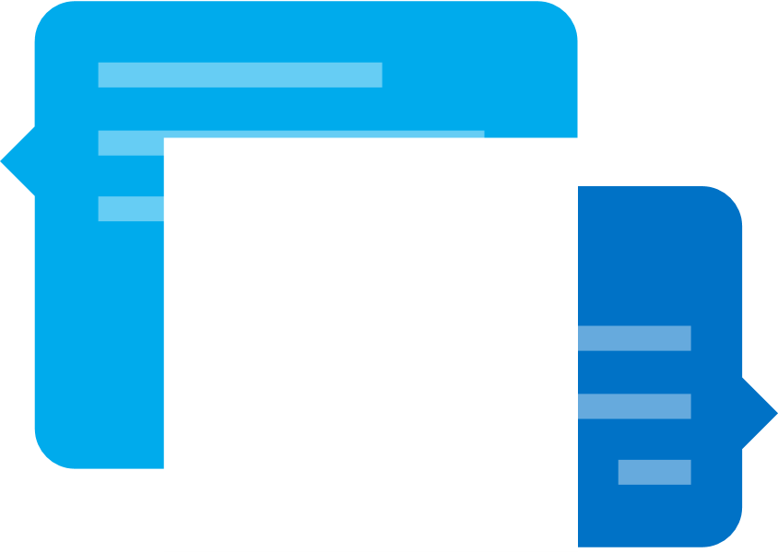
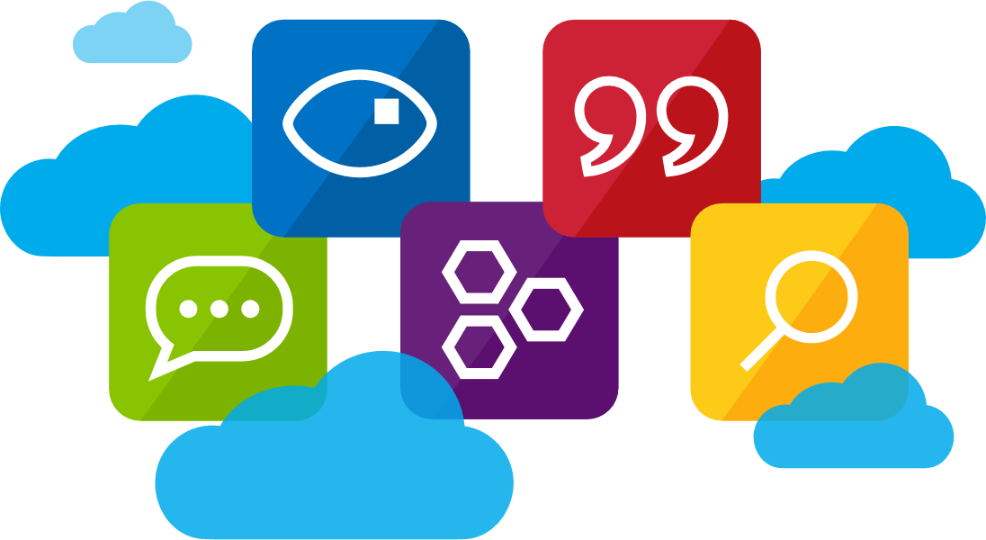
Azure Bot Service
The Azure Bot Service provides tools to connect, deploy, and manage intelligent bots to interact naturally with your users on websites, apps, Cortana, Microsoft Teams, Skype, Slack, Facebook Messenger, and more.
Notes:
The Azure Bot Service provides an integrated environment that is purpose-built for bot development, enabling developers to build, connect, test, deploy, and manage intelligent bots, all from one place.
The Azure Bot Service leverages the Microsoft Bot Framework Bot Builder SDK, supporting .NET and Node.js for code development.

Slide 3


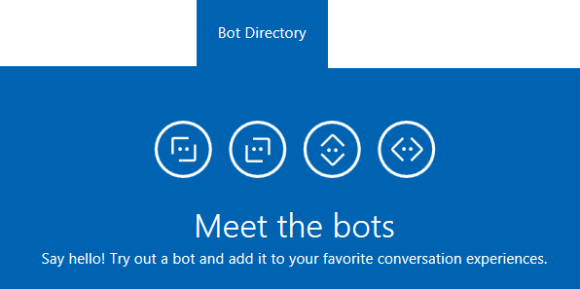
Microsoft Bot Framework
The Microsoft Bot Framework is a comprehensive set of tools and services developers can leverage to build and deploy high-quality, conversational bots in any language.
Notes:
Regardless of the language or platform, developers building bots face the same common challenges: Bots require basic input and output, they need language and dialog skills, they need to be responsive and scalable; and they must connect to users in any conversation experience and language the user chooses. The Microsoft Bot Framework provides the foundation for what developers need to build, connect, manage and publish intelligent bots that interact naturally with users over a variety of services from text/SMS to Skype, Slack, Facebook Messenger, Microsoft Teams, Kik, Office 365 mail and other popular services.

Slide 4
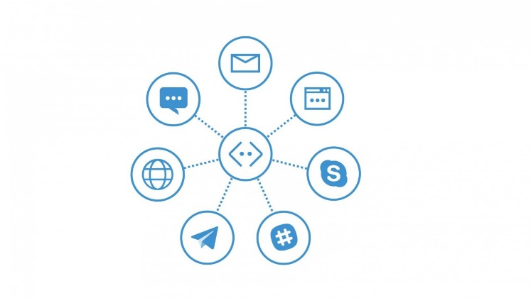
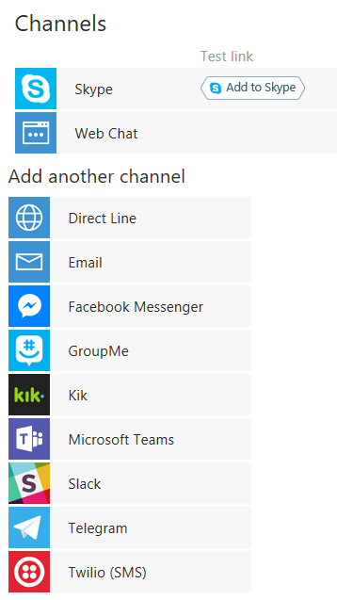
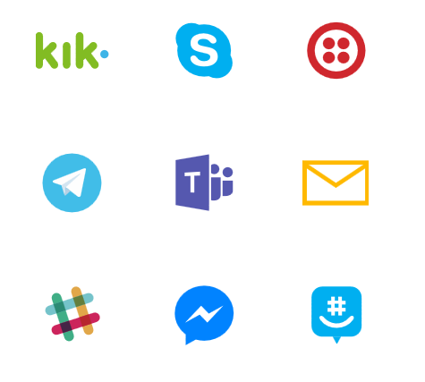
Supported Channels
Channels are currently available for Skype, web, email, Facebook, GroupMe, Microsoft Teams, Kik, Slack, Telegram, Twilio, and direct line app integration.
Notes:
Channels are essentially third party services that a bot can communicate and interaction with in a standardized way. The Microsoft Bot Framework provides developers with a developer portal and SDK to build bots, a Bot Connector service to connect to social channels such as Twitter, Microsoft Teams, and Slack, and a Bot Directory to discover and use existing bots.

Slide 5
The Connector
The Connector (or Connector Service) handles all communication, conversations, state, and authorization activities between a bot and users.
var connector = new ConnectorClient(incomingMessage.ServiceUrl);
var replyMessage = incomingMessage.CreateReply("How can I help?");
await connector.Conversations.ReplyToActivityAsync(replyMessage);
Notes:
The Microsoft Bot Connector is a communication service that helps you connect your bot with many different communication channels (Skype, SMS, email, and others). If you write a conversational bot or agent and expose a Microsoft Bot Framework-compatible API on the Internet, the Bot Framework Connector service will forward messages from your bot to a user, and will send user messages back to your bot. The Connector is the primary mechanism used to communicate all information between a user and a bot, and includes methods to assist with authentication and state management.

Slide 6

Connector Service Flow
CHANNEL
Skype
Web Chat
Email
Facebook
Microsoft Teams
GroupMe
Kik
Slack
Telegram
Twilio
Direct Line
CONNECTOR
Routes messages, manages state, bot registration, tracking, services (such as translation) and per-user and per-bot storage
Your Bot’s Web Service
Notes:
Although all communication between a bot and a channel happens via the Connector., this is not a “technical” requirement, per se, but is instead the entire crux of communicating with diverse channel contracts universally. The Connector handles all the complexity of state management, bot registration, and storage in a way that can extend and apply across all third party services. Communication starts with a user interacting with your bot, then communicating via your bot service, then to the connector, and finally to the third party channel. Responses from the channel always occur in reverse of the user interaction flow.

Slide 7
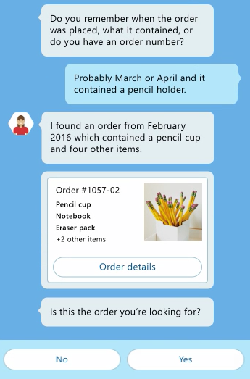
Activities
An Activity is a specific event that occurs between a bot and users, such as an actual message, or conversation notification.
Notes:
An Activity is the object or information used to communicate between a user and a bot. When an Activity is sent, there are a number of properties and methods you can use and populate to control your message and how it gets presented to a user. There are various types of Activities that can be used as well, including Activities to communicate system operations or channel system operations to the bot, enhancing the information about the bot and/or the state of the channel. Every Activity being routed through the Connector has a Type field, which is typically “Message”, however there are system notifications as well, such as “Typing”, “Ping”, or “User Data Deleted” (for when a user leaves a conversation.)

Slide 8
Types of Activities
Activity Type | Description
Message | Sent when general content is passed to or from a user and a bot
Conversation Update | Sent when the conversation's properties change, for example the topic name, or when user joins or leaves the group
Contact Relation Update | Sent when bot added or removed to contact list
Delete User Data | Send when user is removed from a conversation
Typing | Sent when a user is typing
Ping | Send when a keep-alive is needed

Slide 9
Messages
A Message is an overt communication between a bot and users, such as a user asking a question, or a bot responding with a reply.
Message Property | Description
Text | A text payload in markdown syntax which will be rendered as appropriate on each channel.
TextFormat | Plain, markdown, XML (Skype only)
Locale | Two-digit culture/region locale
Notes:
The message activity is the core object exchanged between the user and the bot. It can represent a wide range of values from simple text input and response all the way to complex multiple card carousel with buttons and actions. For many developers, the Text property is the only property you need to worry about. A person sent you some text, or your bot is sending some text back. There are 2 core properties for this, the Text and Locale property.

Slide 10
Intents and Prompts
Mechanisms leveraged by the Microsoft Bot Framework to determine what a user really wants to do are typically referred to as intents and prompts.
?
Notes:
The Microsoft Bot Framework ships with a number of built-in prompts, such as number, text, and confirm, to help a bot determined what a user really intends, or to refine choice during the course of a conversation. These built-in prompts are implemented as a Dialog so they’ll return the users response, typically in a “waterfall” fashion. The built-in prompts also let the user cancel an action by saying something like ‘cancel’ or ‘never mind’ or even “start over”.

Slide 11
Managing State
Not all bots require state management outside of what the Connector provides inherently, however if you need to manage state, there are various methods.
Custom storage methods, such as a remote database
Class-specific logic at runtime
Implicitly during a Dialog or Form process
The Bot Framework State Client
Notes:
Not all bots require state management outside of what the Connector provides inherently, however if you need to manage state, there are various methods. For light-weight, persistent state across sessions, the Bot Framework State Client is ideal, as it retains information based on specific user data and conversational history.

Slide 12
Using Dialogs
Dialogs are a way of wrapping an entire “experience” into an easily managed interaction based on a “chained” and “conversational” paradigm.
Send information to a User
Prompt a User for more information or confirmation
Provide conditional logic
Provide “as you need it” content
Dialogs can contain or forward to other Dialogs
Notes:
Dialogs can help developers create simple bot experiences where a conversation and it’s elements are generally “known”. Dialogs typically leverage the concepts of “intents and prompts” to fine tune what a user really needs. Dialogs can also be nested or chained depending on the results of a prompt or dete4rmined intent, making them ideal for fundamental conversations.

Slide 13
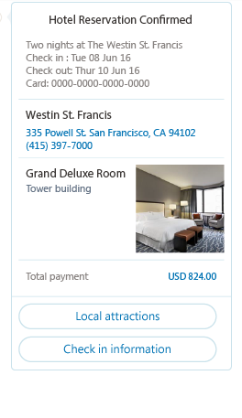
Attachments, Cards, and Actions
Bot conversations can contain enhanced content in the form of Attachments, Cards, and Actions
Media attachments: Image, audio, video, file
Rich card attachments: Hero, thumbnail, receipt, sign-in
Button and card actions: Open URL, call, play audio/video, show image, download file, sign-in
Notes:
Although not universally supported by all channels, most third-party channels provide some ability to attach “rich” objects, meaning content other than text, like audio and video, as well as the ability to have “enhanced” interactions such as viewing images and downloading files. The Microsoft Bot Framework Connector performs all the heavy lifting of connecting attachment data structure to media attachments and rich cards on each channel, and provides failover scenarios where unsupported.

Slide 14
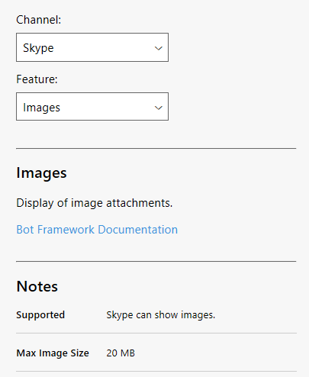
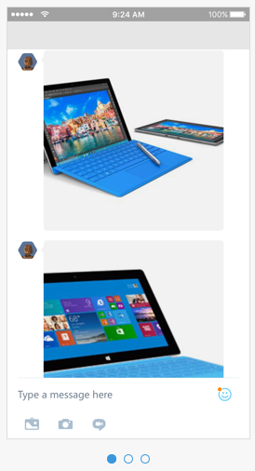
Channel Inspector
The Channel Inspector is a web-based, interactive tool you can use to evaluate supported features for specific chat clients, making it easy to understand the style your users will see and limitations in presentation, based on target chat platforms.
Notes:
Connecting to channels, like Skype, Slack and Microsoft Teams, is easy with the Microsoft Bot Framework platform, however users will often have varied experiences depending on the target platform and supported features. To make it easily to evaluate features on each platform you can use the Channel Inspector, an interactive web tool you can use to browse the features in each chat client.

Slide 15
The Bot Framework Emulator
Emulate bot conversations easily on any device and any supported channel scenario.
Supports Mac, Linux and Windows
View all Bot Framework card types
Save multiple profiles for working offline
Send requests and receive responses to/from your bot endpoint on localhost
Inspect responses, and emulate specific users and conversations
Notes:
The Bot Framework Emulator is one of your most powerful tools in building your bot and supports the following:
- Works on Mac, Linux and Windows
- View all Bot Framework card types are supported
- Save multiple profiles for when you’re working both online and offline
- Simplifies configuration when you’re working with ngrok
- Uses the webchat control for higher fidelity layout and consistency with the webchat experience
- Send requests and receive responses to/from your bot endpoint on localhost
- Inspect the Json response
- Emulate a specific user and/or conversation

Slide 16
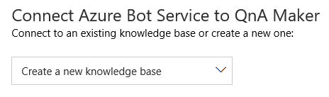
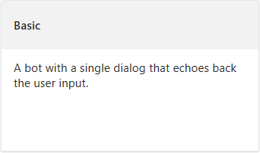
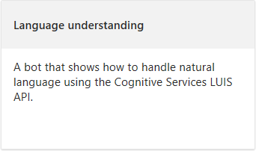
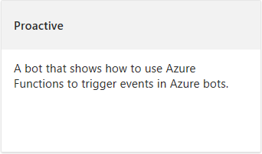
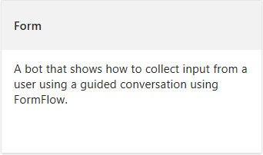
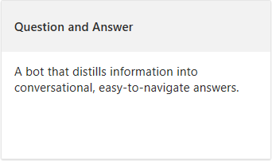
Azure Bot Services
The Azure Bot Service, powered by the Microsoft Bot Framework, provides and integrated environment for managing bot logic and integration, including the ability to edit services without the need for a local editor or source control.
Notes:
You can expedite your bot development by leveraging Azure Bot Services, an Azure-based service that provisions and configures dependent services automatically, as well as providing an integrated environment where you can build, connect, deploy and manage bots.
Azure Bot Services also speeds up initial development by providing out-of-the-box templates to get a developer started, including templates for a basic bot, LUIS bot, form bot, proactive bot, as well as a question and answer (Qna) bot.

Slide 17
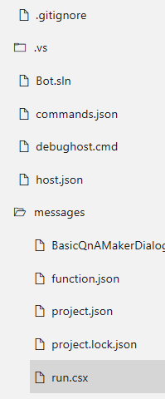
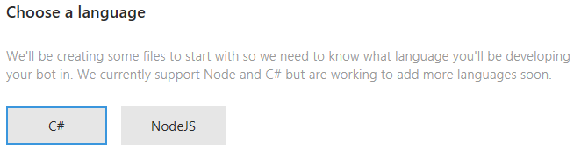
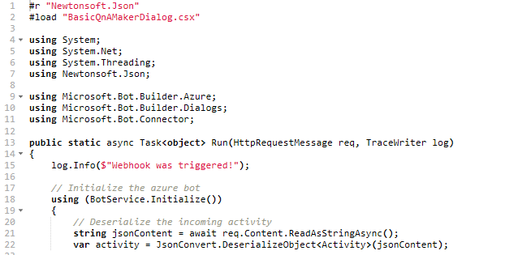
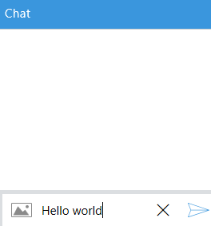
Azure Bot Services
Bots can be created and managed within a browser directly, in both C# and Node.js, using the Azure editor, effectively removing any need for a local editor. You can quickly test your bot directly in the Azure service environment.
Notes:
You can write your bot in C# or Node.js directly in the browser using the Azure editor without any need for a tool chain (local editor and source control). The integrated chat window sits side-by-side with the Azure editor, which lets you test your bot on the fly as you write the code in the browser.
Azure Bot Service is powered by Microsoft Bot Framework and Azure Functions. By using Azure Functions, your bot will run in a serverless environment on Azure that will scale based on demand.

Slide 18



Microsoft QnA Maker
Microsoft QnA Maker is a free REST API and web-based service that enables marketing, support, operations, and developers to train an artificial intelligence engine to respond to user's questions in a natural, conversational, question and answer-based format.
Notes:
Microsoft QnA Maker is a free, cross-platform, easy-to-use, REST API and web-based service that trains AI to respond to user's questions in a more natural, conversational way.
Compatible across development platforms, hosting services, and channels, QnA Maker is a question and answer service with an actual graphical user interface, which means users don’t need to be developers to train, manage, and use it for a wide range of solutions.

Slide 19
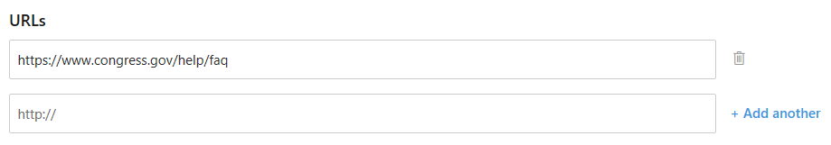
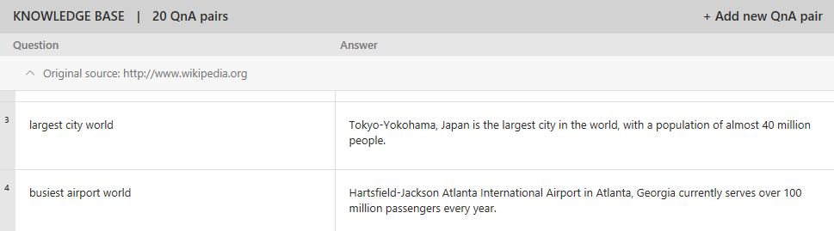
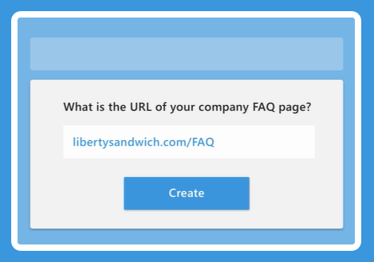
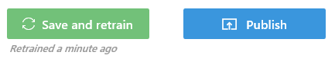
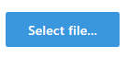
Microsoft QnA Maker
There are several ways to update a QnA knowledge base, including simple FAQ reference via a URL or direct management of QnA question and answer pairs.
Notes:
Creating your knowledge base is as straightforward as point the tool to the existing content via a URL, and “ingesting” the QnA content. The QnA tool can auto-extract question and answer pairs from most FAQ URLs and documents. If a web-based FAQ document is unable to be auto-extracted, there is an option to add QnA pairs individually. If necessary, you can also replace your entire knowledge by importing question and answer key pairs, making it ideal for bulk updates to your knowledge base.

Slide 20
Hands-On Lab
Azure Bot Service HOL.html

